Slide 1

21AG-1D013
«Նոր քիրալային կատալիզատորներ և աքիրալային սուբստրատներ: Ոչ սպիտակուցային ամինաթթուների և այլ պոտենցիալ կենսաակտիվ քիրալային միացությունների կատալիտիկ ասիմետրիկ սինթեզի արդյունավետ մեթոդների մշակում»
ՀՀ ԳԱԱ «Հայկենսատեխնոլոգիա» ԳԱԿ
Զեկուցող՝ ՀՀ ԳԱԱ ակադեմիկոս, պրոֆեսոր Ա․Ս․ Սաղյան

Slide 2
The general scheme of asymmetric synthesis of NPAA
Yu.N.Belokon, A.S.Saghyan, et all. // Тetrahedron, 1988, vol. 44, 5507-5514; A.S.Saghyan, A.V.Geolchanyan, et all. // Tetrahedron: Asymmetry, 2004, vol.15, 705-711; A.S.Saghyan et all. // Tetrahedron: Asymmetry, 2006, vol. 17, 455-467; A.S. Saghyan et all. // Tetrahedron: Asymmetry, 2013, V. 24, pp. 229-232, A. S. Saghyan, H. M. Simonyan et all. Z. Naturforsch. B 2014, p. 451-460, vol. 69b, doi:10.5560/ZNB.2014-322, 2014; A.S. Saghyan, H.M. Simonyan et all// Amino Acids 2014; 46(10): p. 2325-32.

Slide 3
Structure of the new modified catalysts
16 կոմպլեքս
Hovhannisyan, A. M., Tovmasyan, A. S., Mkrtchyan, A. F., Ghazaryan, K. R., Minasyan, E. V., Dallakyan, O. L., Chobanyan, M. S., Zakaryan, H., Roviello, G. N., & Saghyan, A. S. (2024). Molecular Catalysis, 569, 114618. https://doi.org/10.1016/j.mcat.2024.114618
‌

Slide 4
Identified patterns
Hovhannisyan, A. M., Tovmasyan, A. S., Mkrtchyan, A. F., Ghazaryan, K. R., Minasyan, E. V., Dallakyan, O. L., Chobanyan, M. S., Zakaryan, H., Roviello, G. N., & Saghyan, A. S. (2024). Molecular Catalysis, 569, 114618. https://doi.org/10.1016/j.mcat.2024.114618
‌

Slide 5
DFT-calculation data
Change in Gibbs Free Energy (ΔG)
During the Formation of a Binuclear Complex
M(II)-3-AllylSal
small
low ee
M(II)-3-OMeSal
strong
high ee
Sampani, S. I., Aubert, S., Cattoen, M., Griffiths, K., Alaa Abdul-Sada, Akien, G. R., Tizzard, G. J., Coles, S. J., Stellios Arseniyadis, & Kostakis, G. E. (2018). Dinucleating Schiff base ligand in Zn/4f coordination chemistry: synthetic challenges and catalytic activity evaluation. Dalton Transactions (2003. Print), 47(13), 4486–4493. https://doi.org/10.1039/c8dt00538a
‌

Slide 6
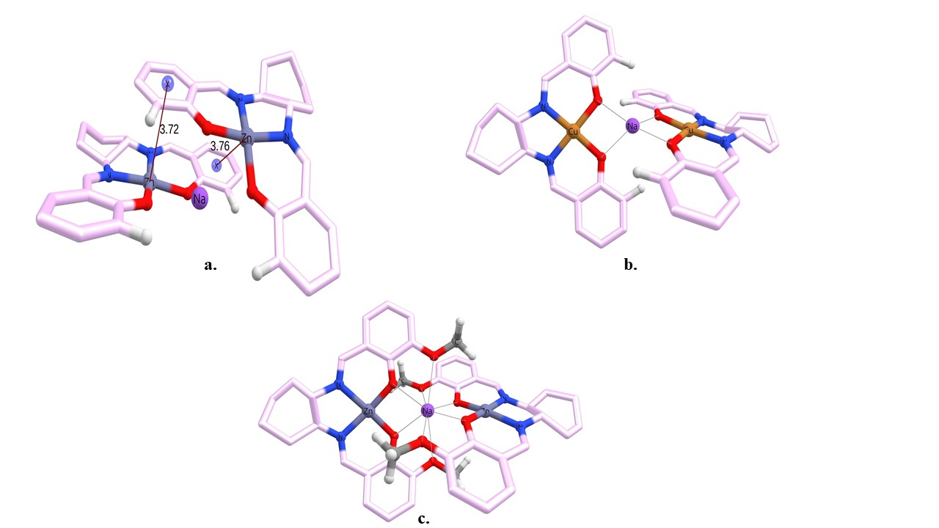
propeller-like structure of unsubstituted binuclear Zn(II) ion complex (1)
3-methoxy substituted binuclear Zn(II) ion complex (2) with restored cross-like structure

Slide 7
Previous work (Belokon’, North)

Slide 8


Alkylating agent | In the presence | Conversion, % | ee, %
AllyBr | - | 95,4 | ~97
 | TEMPO | No reaction
 | DMF (Lewis Base) | No reaction
 | Zn (OAc)₂ (Lewis Acid) | No reaction
 | BEt₃ (radical initiator) | decomposition
 | AINB (65 ⁰C) (radical initiator) | Inhibition 10
BnBr | - | <5
 | AINB (65 ⁰C) | ~70-80
Hovhannisyan, A. M., Tovmasyan, A. S., Hayrapetyan, M., Hovhannisyan, N. A., Mkrtchyan, A. F., Malkov, A. V., & Saghyan, A. S. Zn-salen phase-transfer catalyzed radical Cα-alkylation of benzylidene valine. Highly selective asymmetric synthesis of (S)-allylvaline. Manuscript in preparation, 2025.

Slide 9
Possible radical mechanism of allylation of valine substrate
new substrate
Casey, B. M., & Flowers, R. A. (2011). On the Nature of the Oxidative Heterocoupling of Lithium Enolates. Journal of the American Chemical Society, 133(30), 11492–11495. https://doi.org/10.1021/ja205017e
‌

Slide 10
Nucleophilic addition in the presence of salen complex-catalysts
CH₃NO₂
C₆H₅CH₂Br
CH₂=CH-CH₂-Br
AINB

Slide 11
Structure of the new modified catalysts (Future work)

Slide 12
[2+3]-cycloaddition reaction
Poghosyan, A. S., Khachatryan, E. A., Mkrtchyan, A. F., Mirzoyan, V., Hovhannisyan, A. M., Ghazaryan, K. R., Minasyan, E. V., Langer, P., & Saghyan, A. S. (2024). Amino Acids, 56(1). https://doi.org/10.1007/s00726-024-03430-5
‌
‌

Slide 13
Asymmetric synyhesis of α-substituted O-protected (S)-Ser
Ծրագրի շրջանակներում սինթեզվել են 20-ից ավել ամինաթթու
Tovmasyan, A. S., Mkrtchyan, A. F., Tsaturyan, A. H., Langer, P., Malkov, A. V., & Saghyan, A. S. (2025). New Journal of Chemistry. https://doi.org/10.1039/d5nj00764j
‌

Slide 14
Asymmetric synthesis of chiral β-alanine amide derivatives via the addition of nitrones

Slide 15
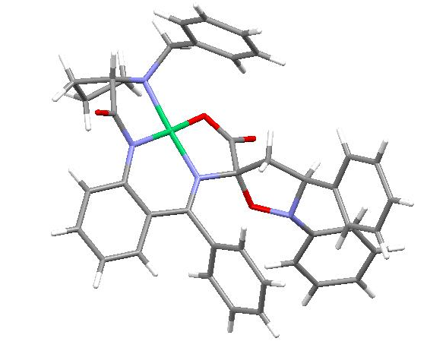

Slide 16
Asymmetric Synthesis and Antibacterial Evaluation of β-Substituted (S)-α-Alanine Analogs Containing a Piperazine Moiety in the Side Chain

Slide 17
Asymmetric Synthesis and Antifungal Evaluation of Benzylamine-Functionalized β-Substituted (S)-α-Alanine Analogues as Unnatural Amino Acid Derivatives

Slide 19
What are our Plans for the Future?
Modernization of complexes and optimization of methodology with the aim of developing highly efficient systems for the asymmetric synthesis of amino acids.
Creation of solid-phase systems for the realization of amino acids transformations in dynamic mode, including cross-coupling reaction.

Slide 20

Խմբի անդամներ
Երիտասարդ գիտաշխատող
Թեկնածուական
Պողոսյան Արտավազդ Սերյոժայի
Ասիմետրիկ սինթեզ
Թովմասյան Աննա Սեդրակի
Ստեփանյան Լալա Աշոտի
Իսրայելյան Ռուբեն Էդուարդի
Հովհաննիսյան Անահիտ Մխիթարի
Կենսաբժշկական սկրինինգ
Գասպարյան Աննա Արմենի

Slide 21
Tovmasyan AS, Mkrtchyan AF, Tsaturyan AH, Langer P, Malkov AV, Saghyan AS. Strategy for synthesizing O-protected (S)-α-substituted serine analogs via sequential Ni(ii)-complex-mediated cross-coupling and cycloaddition reactions. New Journal of Chemistry. Published online 2025. doi: https://doi.org/10.1039/d5nj00764j (Q2)
Aniskina IS, Shandyboab MA, Kuznetsovaa SA, Biriukova KO, Ilyin MM Jr., Ezernitskayaa MG, Kutumova SP, Poghosyan AS, Saghyan AS, Chernyshevd VP, Chusova DA, Belokon YuN. Chiral hydrogen-bonded frameworks featuring proline motifs as heterogeneous catalysts for the enantioselective synthesis of warfarin. Mendeleev Communications. 2025;35(6):642–644 (Q3).
Tovmasyan AS, Mkrtchyan AF, Khachatryan HN, Hayrapetyan MV, Hakobyan RM, Poghosyan AS, Tsaturyan AH, Minasyan EV, Maleev VI, Larionov VA, Ayvazyan AG, Shibata N, Roviello GN, Saghyan AS. Synthesis, characterization, and study of catalytic activity of chiral Cu(II) and Ni(II) salen complexes in the α-amino acid C-α alkylation reaction. Molecules. 2023;1180 (Q1).
Gugkaeva ZT, Mardiyan ZZ, Smol’yakov AF, Poghosyan AS, Saghyan AS, Maleev VI, Larionov VA. Sequential Heck cross-coupling and hydrothiolation reactions taking place in the ligand sphere of a chiral dehydroalanine Ni(II) complex: Asymmetric route to β-aryl substituted cysteines. Organic Letters. 2022;6230–6235 (Q1).
Emma A. Khachatryan, Lusine Yu. Sahakyan, Anna S. Tovmasyan, Gagik S. Melikyan, Henrik A. Panosyan, Anna F. Mkrtchyan *, Norio Shibata, Andrei V. Malkov * and Ashot S. Saghyan *// Sequential Michael addition, cross-coupling and [3 + 2] cycloaddition reactions within the coordination sphere of chiral Ni(II) Schiff base complexes derived from dehydroamino acids: pathways to the asymmetric synthesis of structurally diverse O-substituted serine and threonine analogs, RSC Advances, 2025, 15, 10558-10564. (Q1)

Slide 22
Khachatryan EA, Mkrtchyan AF, Hovhannisyan AM, Ghazaryan M, Saghyan AS. Asymmetric synthesis and antibacterial evaluation of β-substituted (S)-α-alanine analogs containing a piperazine moiety in the side chain. Chirality. First published April 6, 2026. DOI: 10.1002/chir.70098 (Q2).
Khachatryan EA, Stepanyan LA, Gevorgyan HR, Sargsyan AS, Hovhannisyan AM, Mkrtchyan AF, Malkov AV, Saghyan AS. Synthesis of enantiomerically enriched β-N-amino (S)-α-alanine analogs via sequential reactions on a chiral Ni(II) complex. Organic & Biomolecular Chemistry. 2026 (Q2).
Anahit M. Hovhannisyan, Anna S. Tovmasyan, Anna F. Mkrtchyan*, Karapet R. Ghazaryan, Ela V. Minasyan, Olgert L. Dallakyan, Mikayel S. Chobanyan, Hayk Zakaryan, Giovanni N.Rovello, Ashot S.Saghyan*// Synthesis and evaluation of new mono- and binuclear salen complexes for the Cα-alkylation reaction of amino acid substrates as chiral phase transfer catalysts, Molecular catalysis 569 (2024)114618 (Q1).
Poghosyan, A. S., Khachatryan, E. A., Mkrtchyan, A. F., Mirzoyan, V., Hovhannisyan, A. M., Ghazaryan, K. R., Minasyan, E. V., Langer, P., & Saghyan, A. S. (2024). Synthesis of enantiomerically enriched β-substituted analogs of (S)-α-alanine containing 1-phenyl-1H-1,2,3-triazole groups. Amino Acids, 56(1). https://doi.org/10.1007/s00726-024-03430-5 (Q1)
Asymmetric Synthesis and Antifungal Evaluation of Arylalkylamine-Functionalized β-Substituted (S)-α-Alanine Analogues (manuscript)

Slide 23
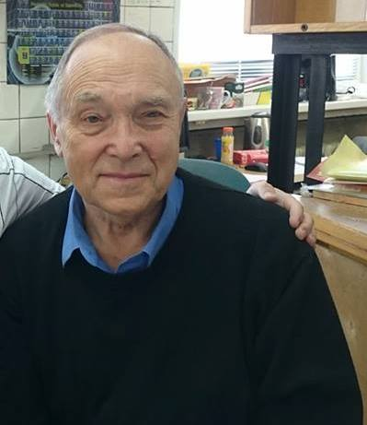
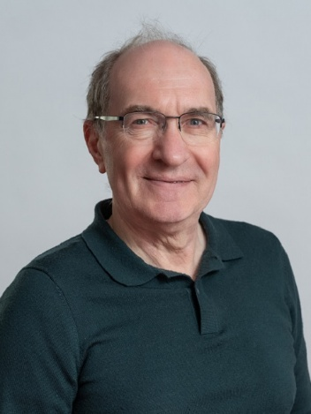
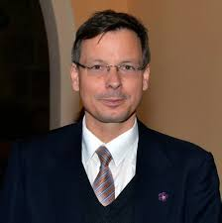
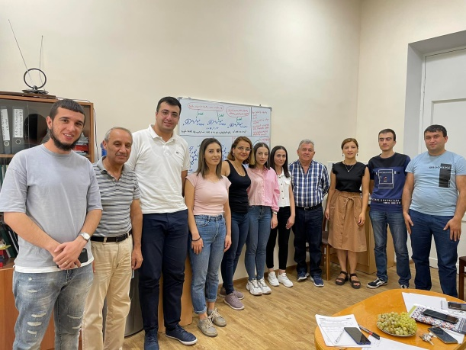
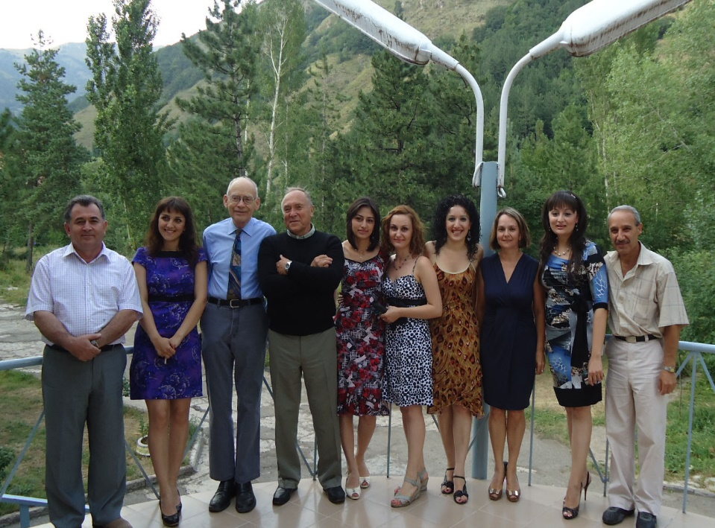
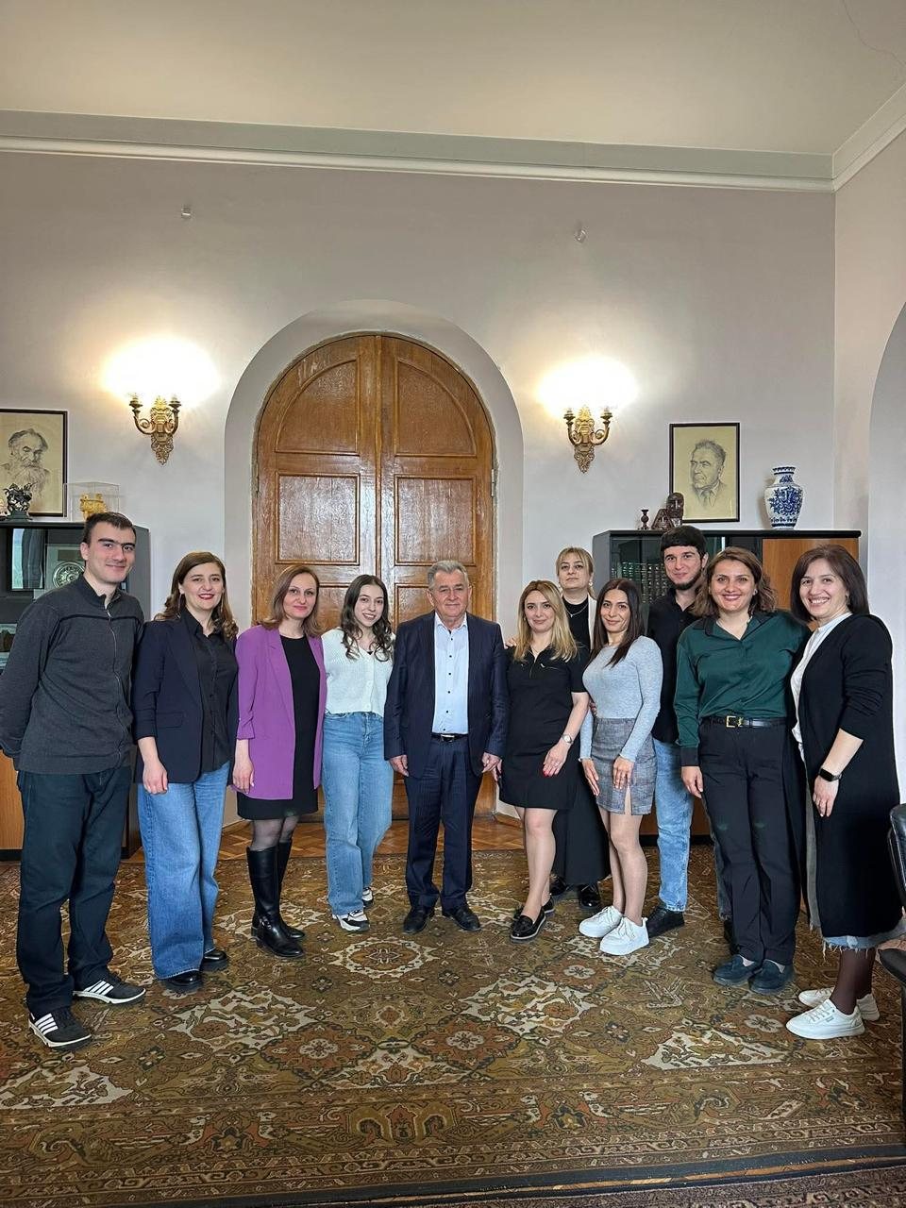
Prof. Yu.N. Belokon’,
INEOS RAS
Prof. A. Malkov,
Loughborough University
Prof. P. Langer,
University of Rostock

Slide 24
Thank you for your attention!!!
Ashot Saghyan
Professor, Doctor of Chemistry
Director of the Scientific Research Center of the Institute of Pharmacy
President of the National Academy of Sciences of the Republic of Armenia (NAS RA)
ashot.saghyan@sci.am
saghyan@ysu.am
https://orcid.org/0000-0002-3124-170X
Scopus ID: 15822740500

